Slide 1
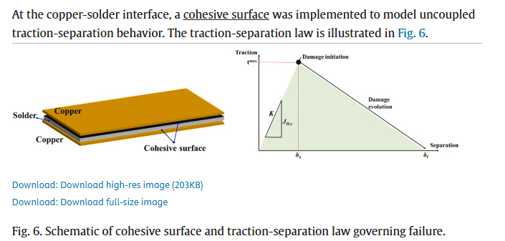
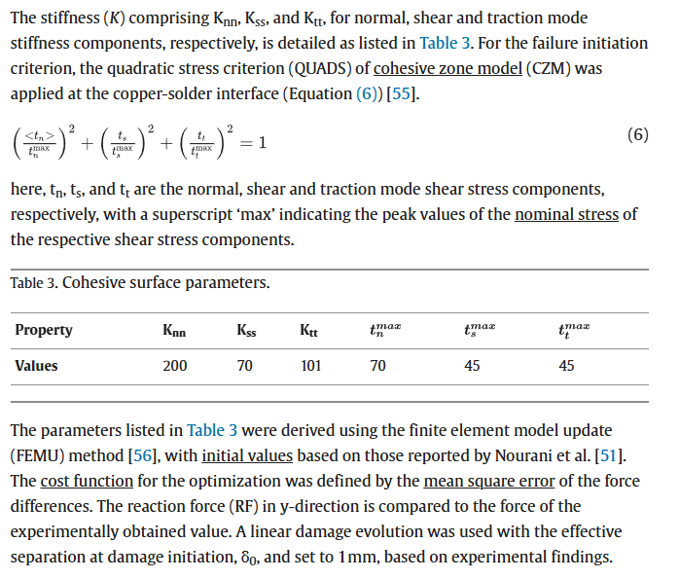
https://www.sciencedirect.com/science/article/pii/S2405844024092739
Single reference point for strain
Modeled solder-copper bond as a cohesive surface

Slide 2
https://www.sciencedirect.com/science/article/pii/S1359431113008831
Uses Anand’s vistoplastic material model
Also uses volumetric strain energy concentration to show where the damage sites are

